Slide 1


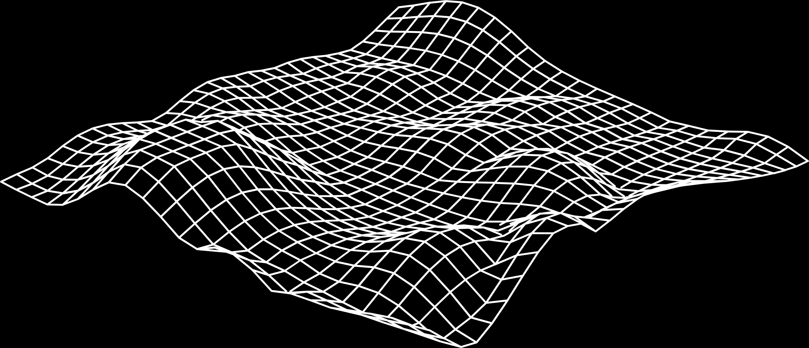
FakeNEAT:
Neuroevolución
mediante AG y Enfriamiento Simulado
HUGO ALBERT BONET

Slide 2
↖ ↗
↘ ↙
DESCRIPCIÓN DEL PROBLEMA
1

Slide 3
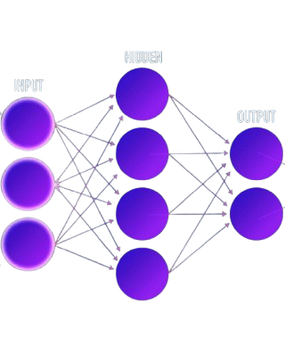
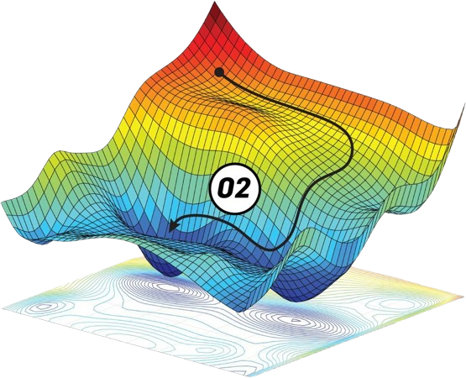
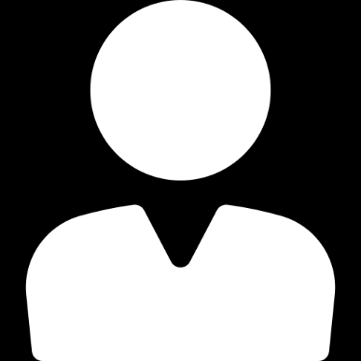
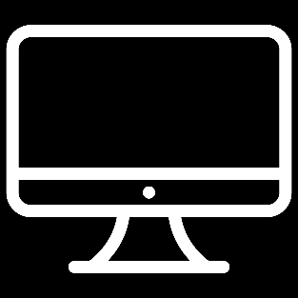
Entrenamiento de Redes Neuronales
Búsqueda de arquitecturas
Entrenamiento de la red
↗
¿Nº capas?
↗
¿Nº neuronas?

Slide 4
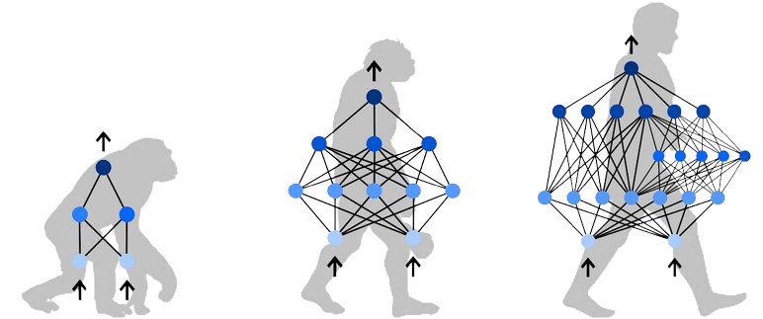
Neuroevolución
¿Qué es?
Algoritmos evolutivos para entrenar redes neuronales buscando al mismo tiempo la mejor arquitectura
Estado del arte:
- NeuroEvolution of Augmented Topologies (NEAT)
- HyperNEAT

Slide 5
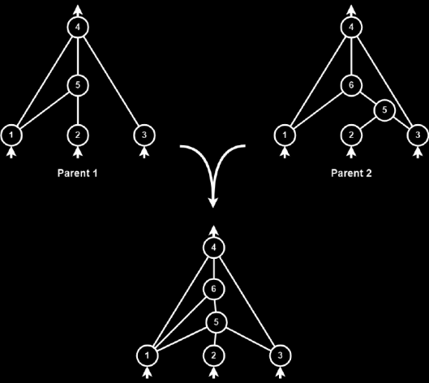
NEAT vs FakeNEAT
NEAT
FakeNEAT
Centrado en optimizar:
Neuronas de cada capa
Pesos de la red
Limitaciones:
Número de capas
Funciones de activación
Capas especiales (Convolucionales, Batch Normalization…)
Principal problema: Poco óptimo para inferencia

Slide 6
↖ ↗
↘ ↙
ALGORITMO GENÉTICO
2

Slide 7

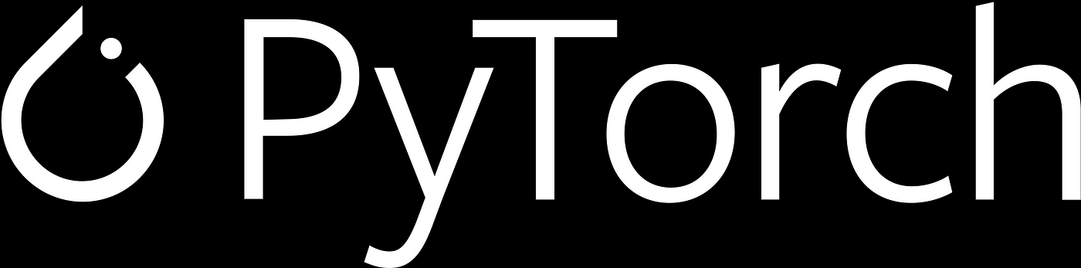
Representación de la solución
Solución = Arquitectura + Pesos
Aquitectura:
[N₁, N₂, … , N_{H}] → N_{h}: Número de neuronas en la capa h.
H: Número de capas de la red (hiperparámetro).
Pesos:
Implementados sobre la librería PyTorch

Slide 8
Población inicial
Búsqueda de simplicidad
Búsqueda de variabilidad
Una neurona por capa:
Parte de la solución más simple y eficiente computacionalmente
Genera redes “grandes” si produce un beneficio
Número aleatorio de neuronas por capa:
Se establece un máximo de neuronas iniciales por capa
Incrementa la variabilidad inicial (Exploración)

Slide 9
Función fitness
DATOS

Slide 10
Función fitness
DATOS
TRAIN
TEST
VALID

Slide 11
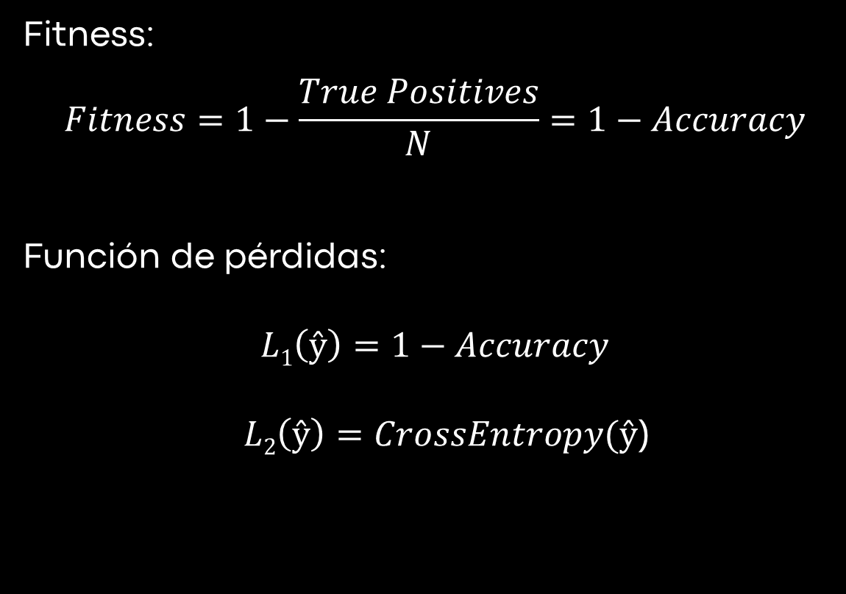
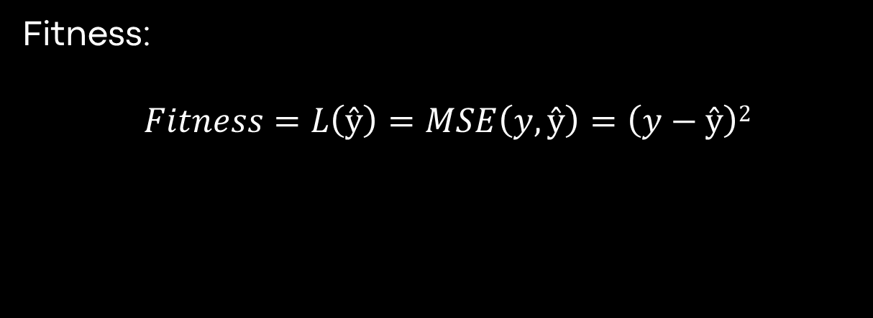
Función fitness
Clasificación
Regresión
Fitness:
$$Fitness=1−\frac{True Positives}{N}=1−Accuracy$$
Función de pérdidas:
$$L1\left(ŷ\right)=1−Accuracy$$
$L2\left(ŷ\right)=CrossEntropy(ŷ$)
Fitness:
$$Fitness=L\left(ŷ\right)=MSE\left(y, ŷ\right)=\left(y−ŷ\right)2$$

Slide 12
Mutaciones
Eliminar neuronas:
Elimina un número aleatorio de neuronas a una capa aleatoria (dejando siempre al menos una neurona restante en la capa).
Añadir neuronas:
Añade un número aleatorio de neuronas (en un rango establecido) a una capa aleatoria.
Mini-train:
Ejecuta una iteración del algoritmo de backpropagation en un minibatch.

Slide 13
Mutaciones
Eliminar neuronas:
Elimina un número aleatorio de neuronas a una capa aleatoria (dejando siempre al menos una neurona restante en la capa).
Añadir neuronas:
Añade un número aleatorio de neuronas (en un rango establecido) a una capa aleatoria.
Mini-train:
Ejecuta una iteración del algoritmo de backpropagation en un minibatch.

Slide 14
Mutaciones
Eliminar neuronas:
Elimina un número aleatorio de neuronas a una capa aleatoria (dejando siempre al menos una neurona restante en la capa).
Añadir neuronas:
Añade un número aleatorio de neuronas (en un rango establecido) a una capa aleatoria.
Mini-train:
Ejecuta una iteración del algoritmo de backpropagation en un minibatch.

Slide 15
Crossover
PARENT 1
PARENT 2

Slide 16
Crossover
IDX = RANDOM INT
PARENT 1
PARENT 2

Slide 17
Crossover
IDX = RANDOM INT
PARENT 1
PARENT 2

Slide 18
Crossover
IDX = RANDOM INT
PARENT 1
PARENT 2
+

Slide 19
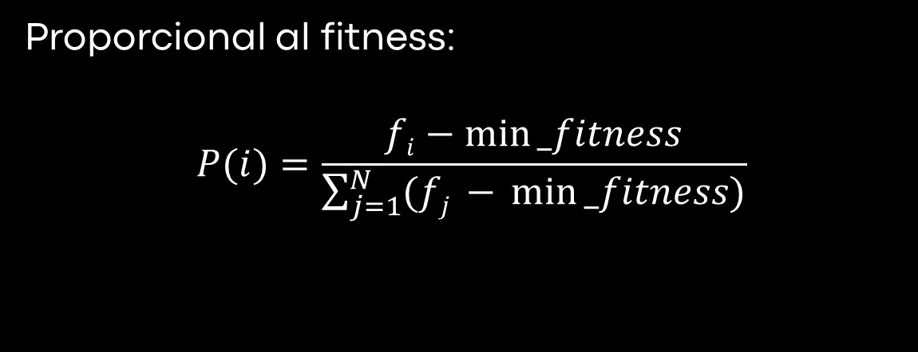
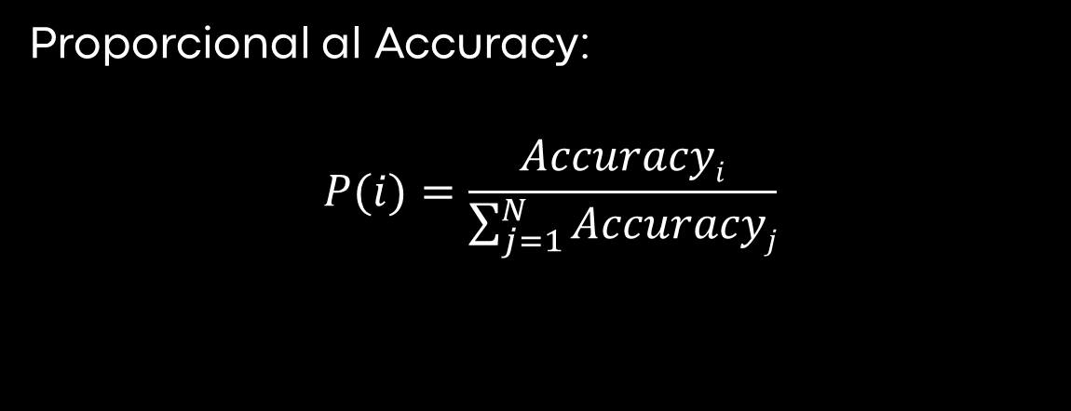
Selección y reemplazo
Selección
Reemplazo
Proporcional al Accuracy:
$$P(i)=\frac{Accuracyi}{\sum_{j=1}^{N}{Accuracyj}}$$
Proporcional al fitness:
$$P(i)=\frac{fi−min⁡_fitness}{\sum_{j=1}^{N}{(fj −} min⁡_fitness)}$$

Slide 20
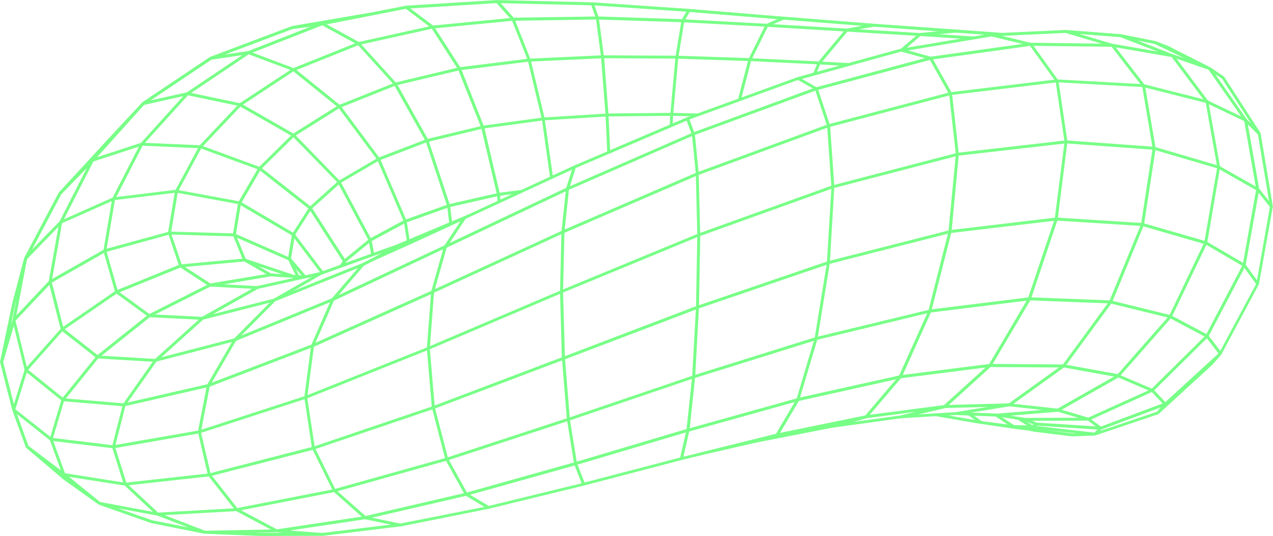
NEAT vs FakeNEAT
O
O
1
INTRODUCTION TO ARTIFICIAL NEURAL NETWORKS: CONCEPTS, APPLICATIONS AND CHALLENGES
2
RECENT ADVANCES IN ARTIFICIAL NEURAL NETWORK ARCHITECTURES AND ALGORITHMS
O
O
3
ARTIFICIAL NEURAL NETWORKS FOR NATURAL LANGUAGE PROCESSING AND COMPUTER VISION
4
ARTIFICIAL NEURAL NETWORK OPTIMIZATION TECHNIQUES AND FUTURE DIRECTIONS

Slide 21
↖ ↗
↘ ↙
BRAND
MESSAGING
1
ELABORATE ON WHAT YOU WANT TO DISCUSS

Slide 22
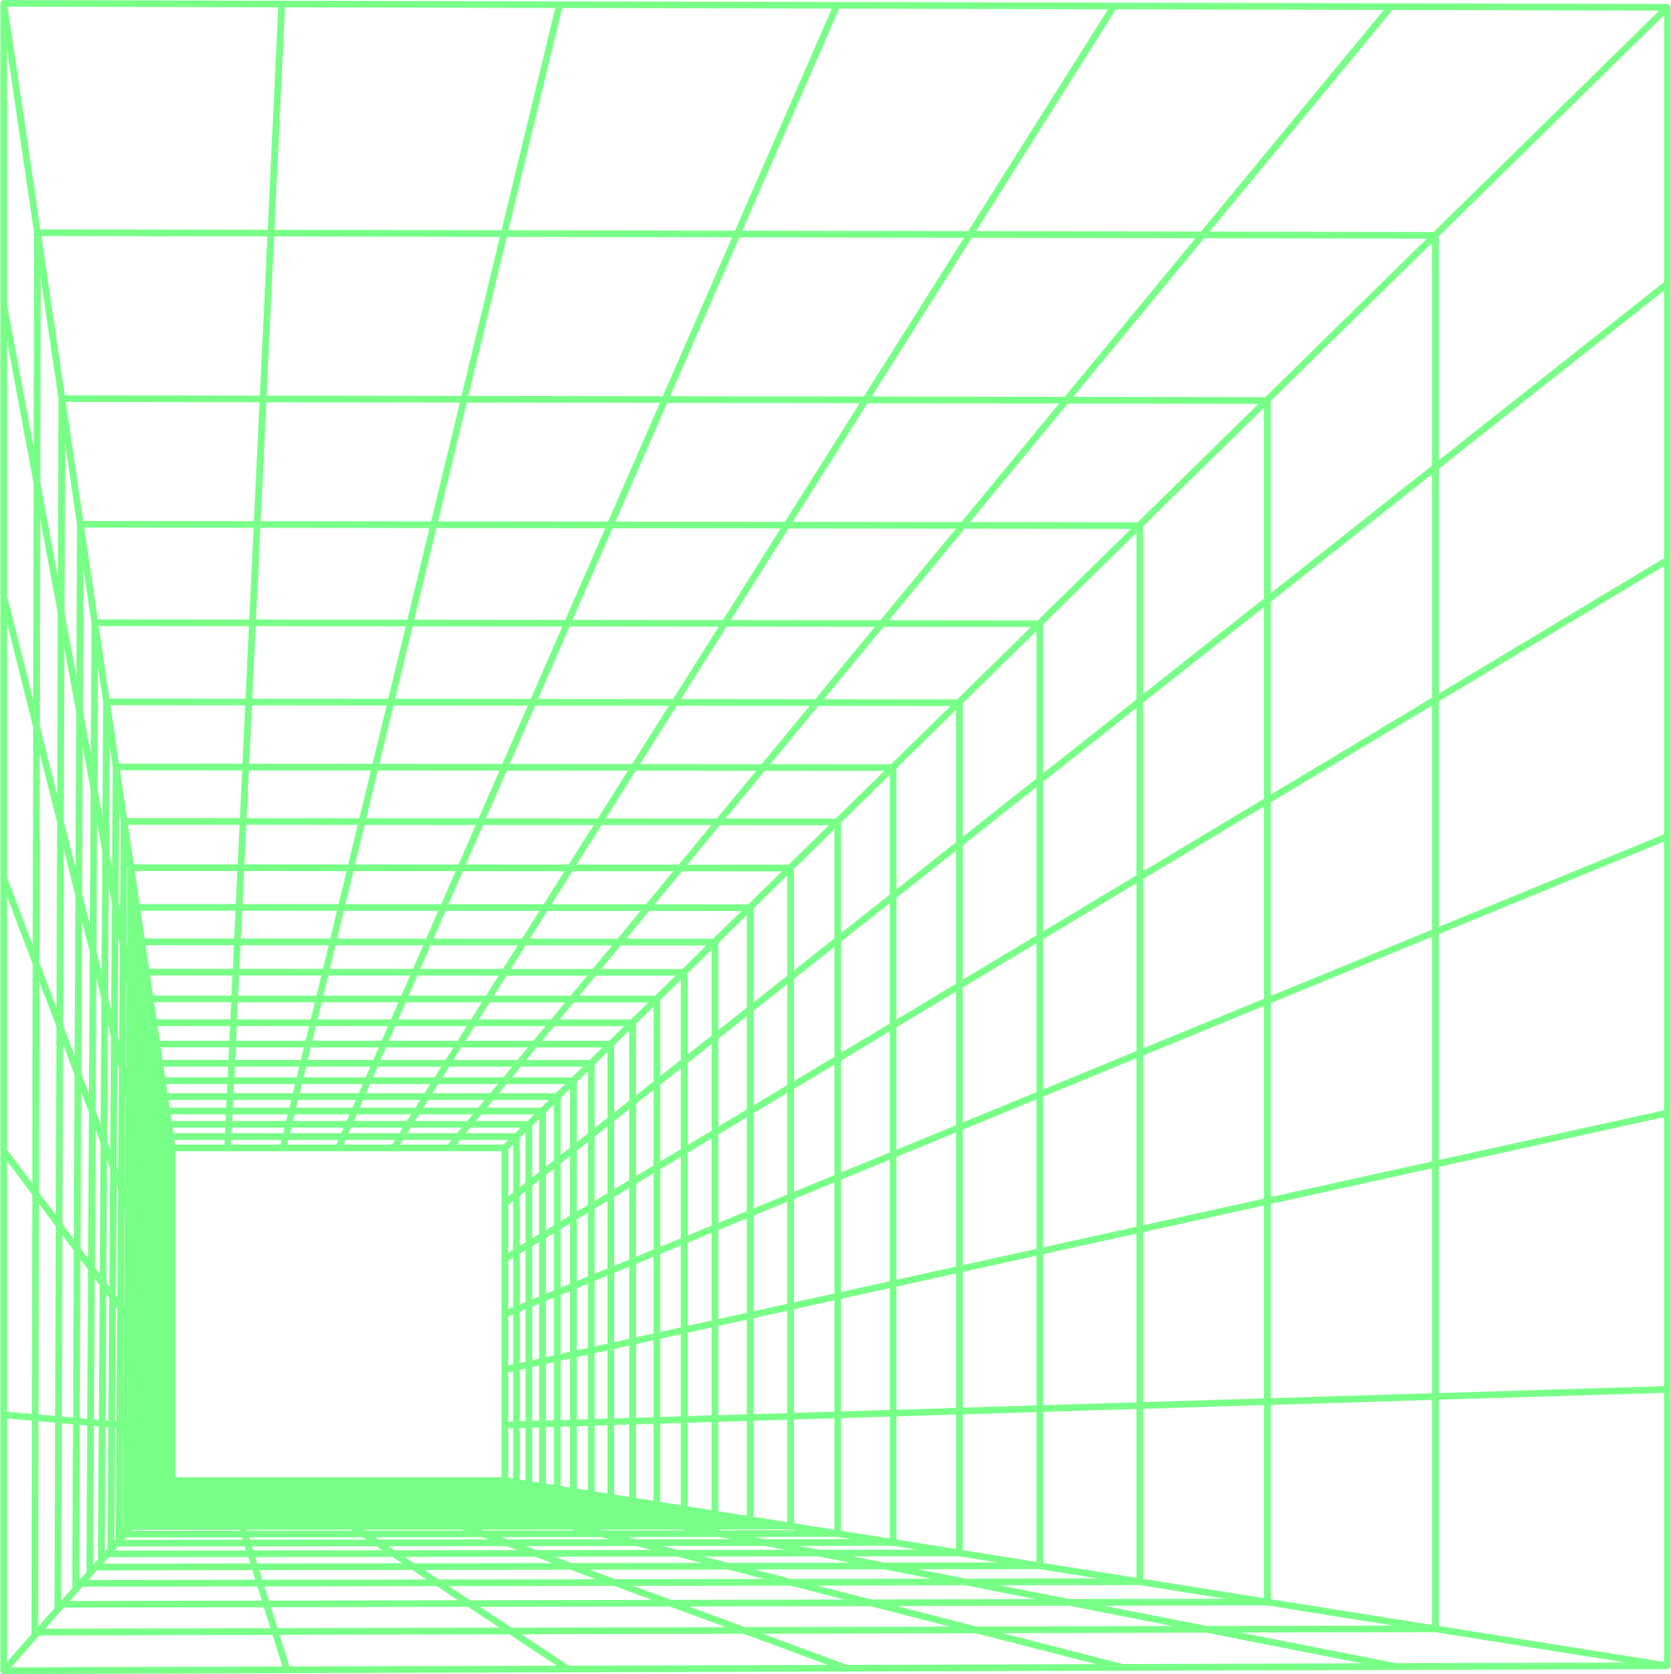
WELCOME
to the Artificial Neural Network Conference 2023, the top event for artificial neural network enthusiasts. We have amazing speakers who will share their knowledge and skills in various domains. You will find everything you need to know about the conference on this page, such as the venue, the dates, the registration, and the program.
You can also check out the speaker bios, the talk abstracts, and the recordings (after the conference). Don't miss this opportunity to learn and network at the conference!
ANNC2023.DEV

Slide 23
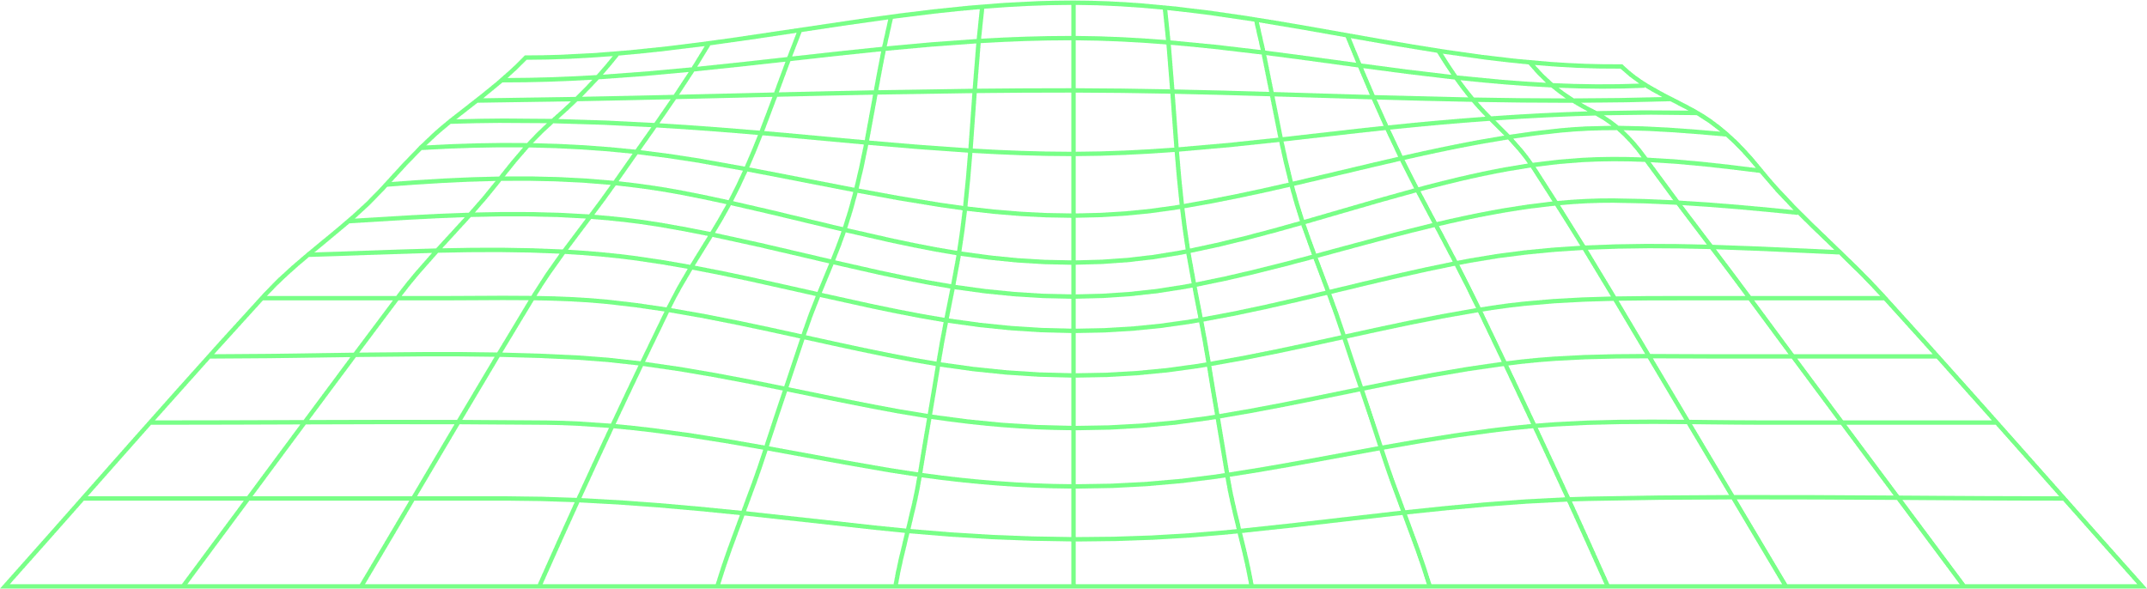
ABOUT CONFERENCE
WHO WE ARE?
WHAT WE DO?
We are a diverse and inclusive community of experts, innovators, and learners who share a common passion for advancing the science and applications of artificial neural networks. We come from different backgrounds, disciplines, and industries, but we are united by our curiosity, creativity, and collaboration.
We organize an annual conference that showcases the latest developments and breakthroughs in artificial neural network research and practice. We provide a platform for exchanging ideas, networking, and learning from each other. We also foster a culture of excellence, integrity, and openness in our field. Our conference features keynote speakers, invited talks, workshops, tutorials, poster sessions, and social events.

Slide 24
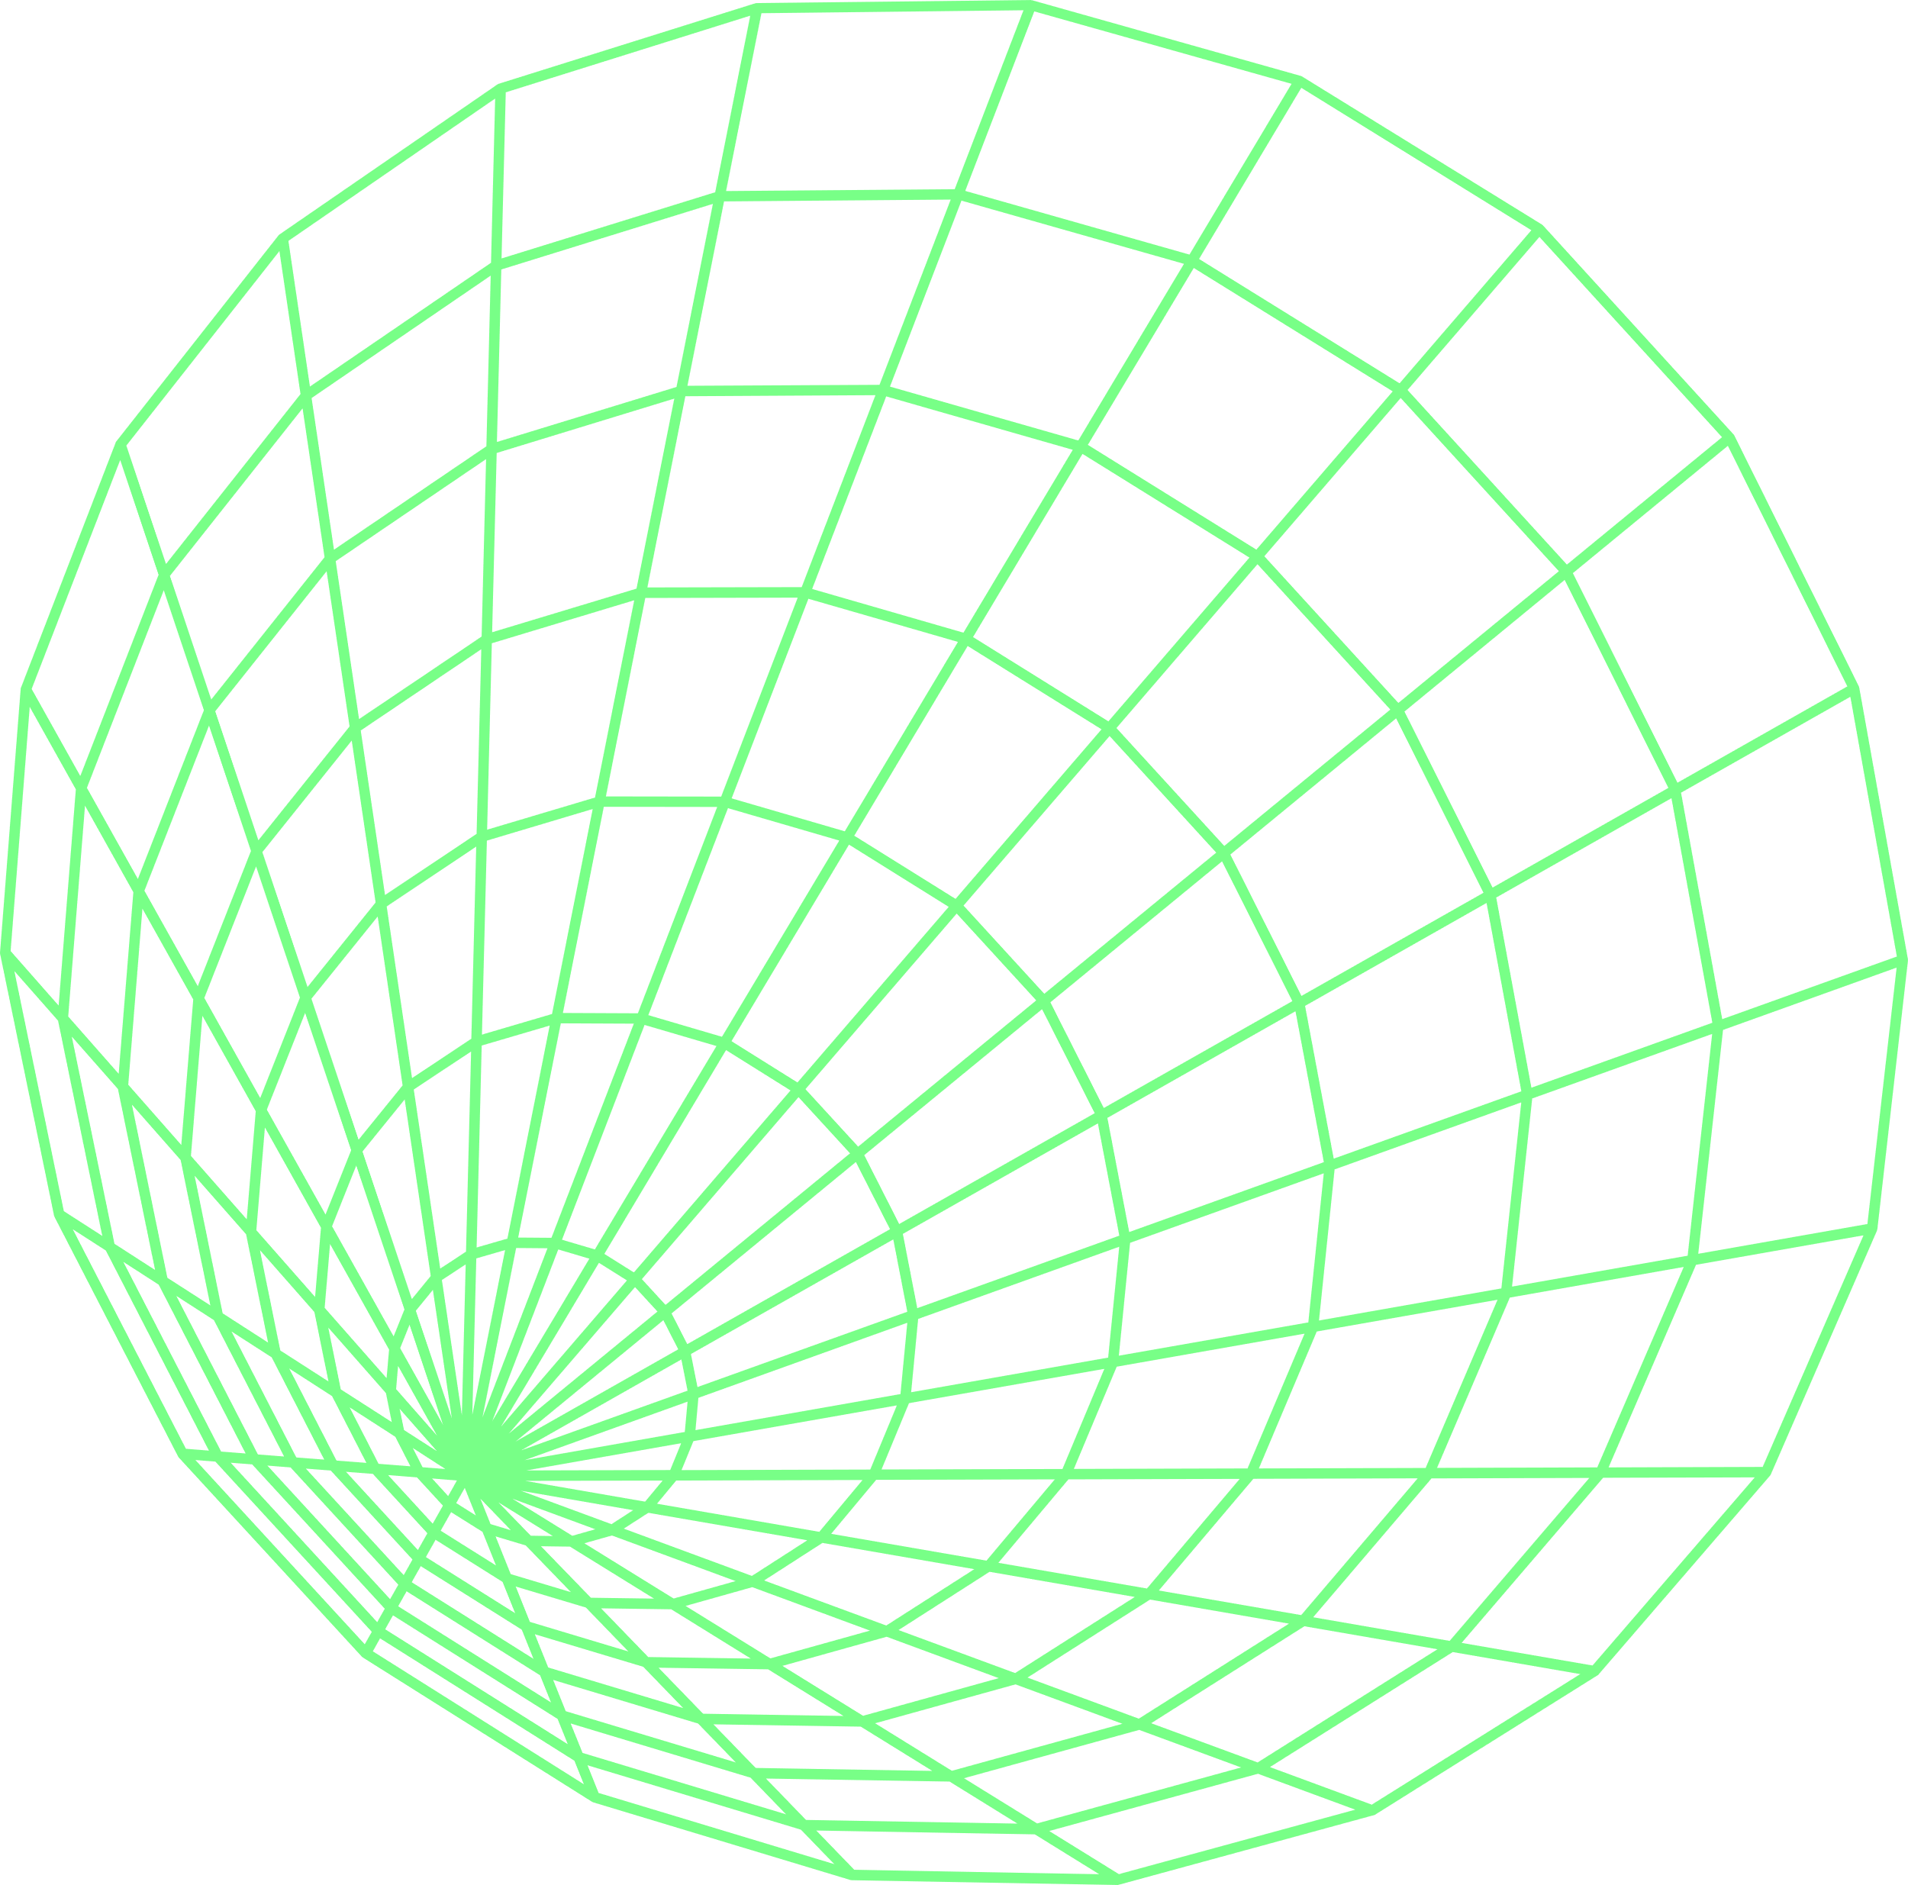
HISTORY
The Artificial Neural Network Conference (ANNC) is a yearly event for researchers and practitioners who work with artificial neural networks. The conference covers various topics and applications of artificial neural networks in different fields and domains.
The first ANNC was held in 1995 in San Francisco, USA, by a group of pioneers and leaders in the field. The conference has been hosted in different countries and continents since then and has attracted more than 300 participants each year. The conference also gives the ANNC Best Paper Award to the most outstanding and innovative papers.
The ANNC is a platform for sharing, learning, and networking on artificial neural networks. It welcomes anyone interested in artificial neural networks and their applications.

Slide 25
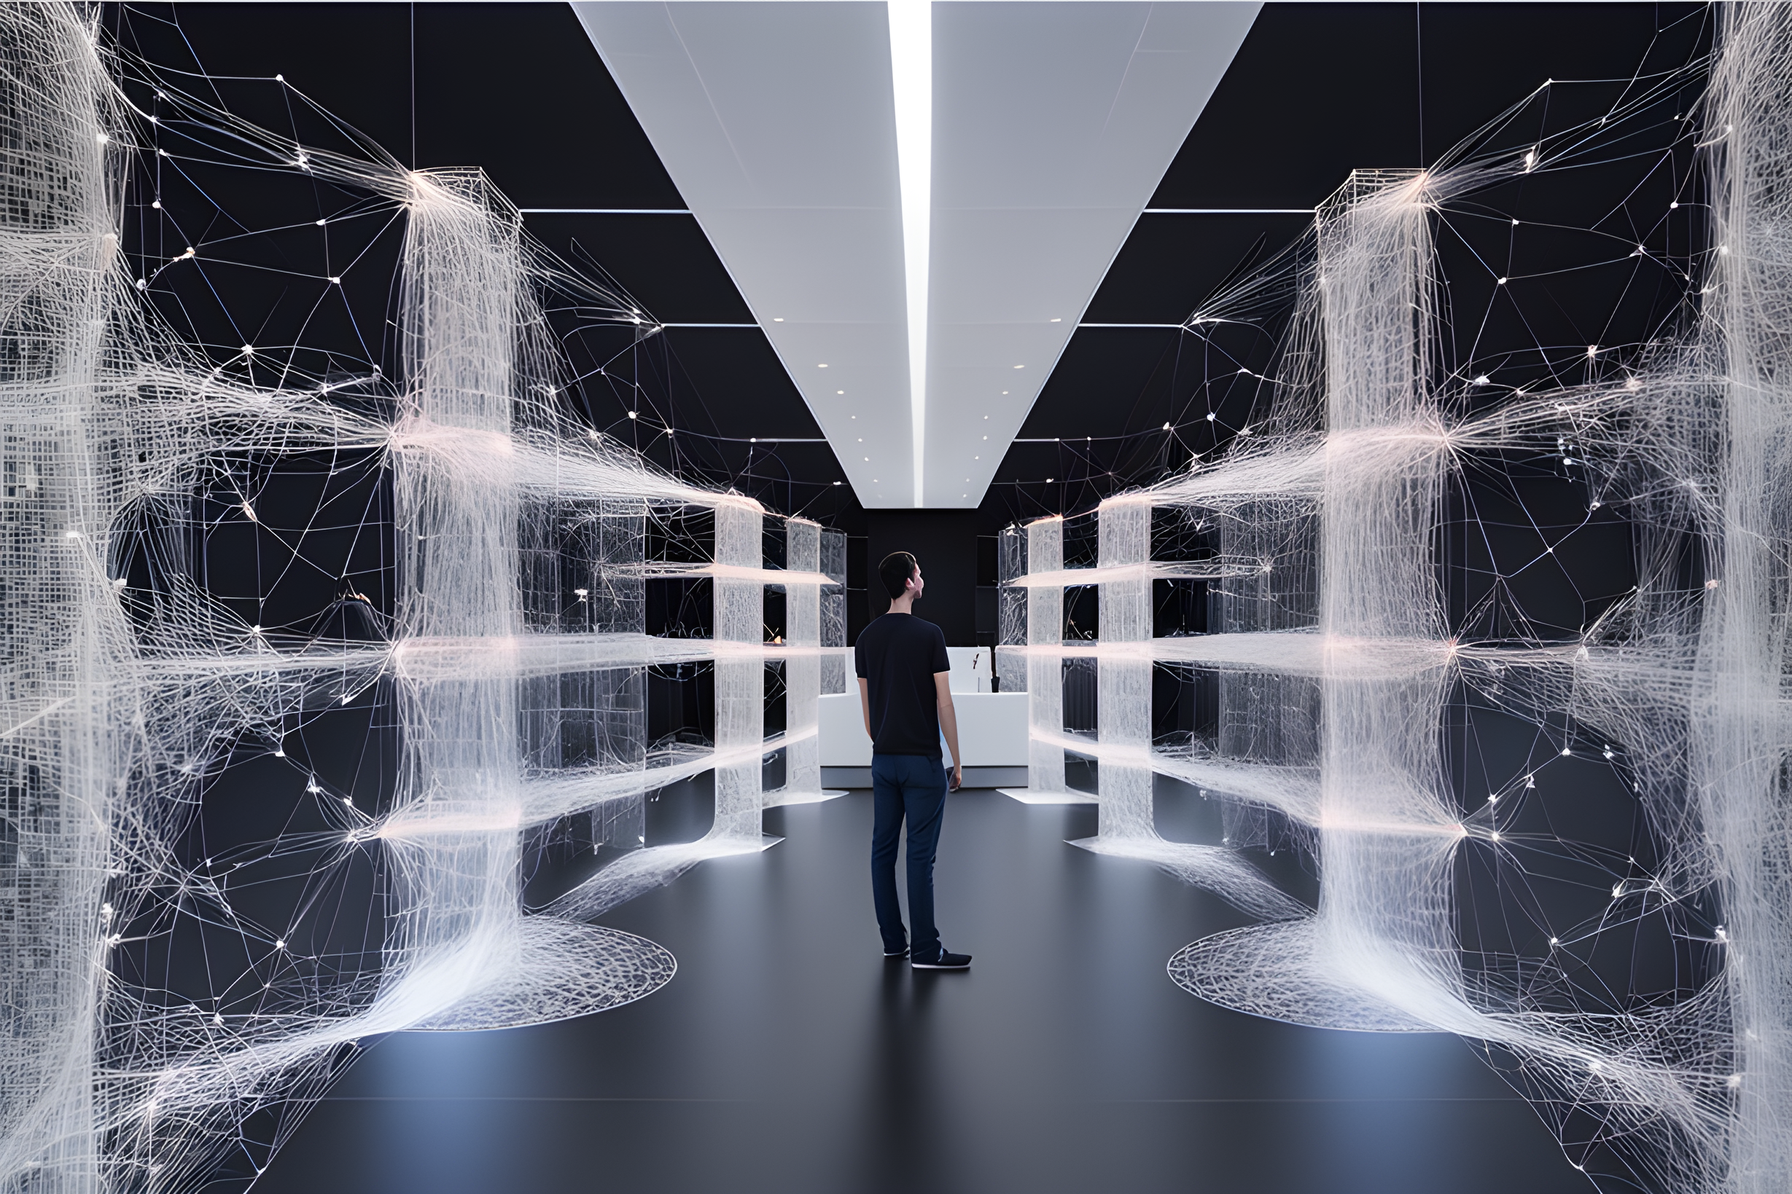
TRANSFORMING SCIENCE INTO ART.

Slide 26
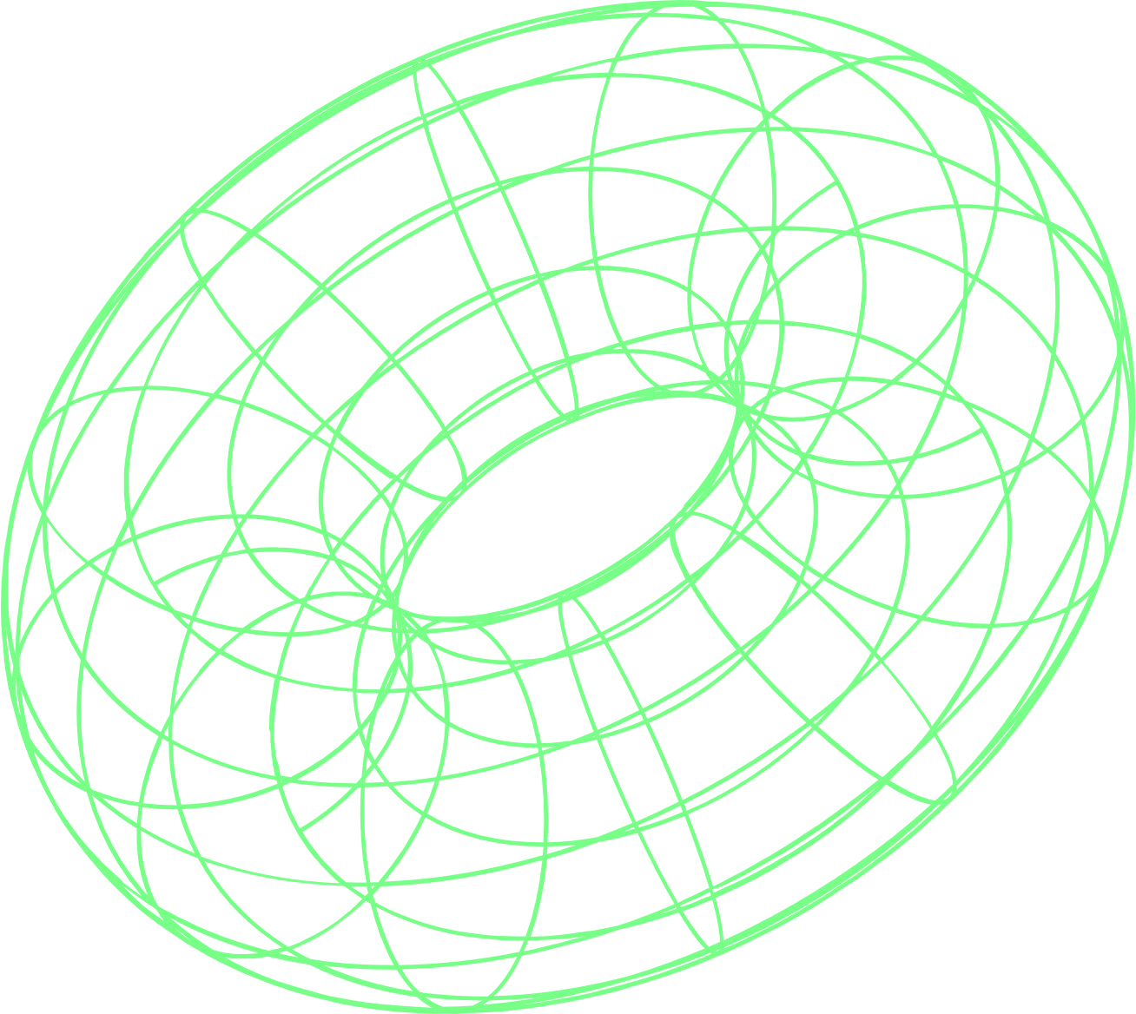
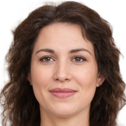
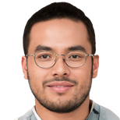
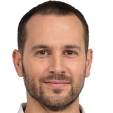
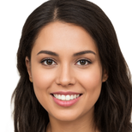
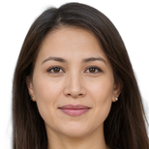
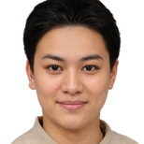
SPEAKERS
Welcome to the Artificial Neural Network Conference 2023! We are excited to introduce you to our amazing team of organizers, speakers and volunteers who are working hard to make this event a success.Here are some of their names and positions, along with a brief bio.
O
O
Alice Smith,
Chair
Alice is a professor of computer science at the University of Oxford, where she leads the Machine Learning Research Group. She has published over 100 papers on various topics in artificial neural networks, such as deep learning, generative models and reinforcement learning.
David Chen,
Program Committee Co-chair.
David is a director of research at Facebook AI Research (FAIR), where he leads the Computer Vision Group. He is an expert in image recognition, face detection and recognition, and video understanding. He has received several awards for his contributions to the field, such as the CVPR Best Paper Award and the ICLR Test of Time Award.
O
O
Bob Jones,
Co-chair
Bob is a senior researcher at Google Brain, where he works on developing novel algorithms and architectures for large-scale neural network systems. He is also an adjunct professor at Stanford University, where he teaches courses on deep learning and natural language processing.
Eva Garcia,
Speaker Liaison.
Eva is a postdoctoral researcher at the Massachusetts Institute of Technology (MIT), where she works on developing neural network models for natural language generation and dialogue systems. She is also a co-founder of Neuralink, a startup that aims to create brain-computer interfaces using neural networks.
O
O
Carol Lee,
Program Committee Chair.
Carol is a principal scientist at Amazon AI, where she oversees the research and development of cutting-edge neural network applications for e-commerce, speech and vision. She is also a fellow of the Association for the Advancement of Artificial Intelligence (AAAI) and the IEEE.
Frank Wang,
Volunteer Coordinator.
Frank is a PhD student at the University of California, Berkeley, where he studies neural network optimization and robustness. He is also a core contributor to PyTorch, an open-source framework for deep learning. He enjoys organizing hackathons and workshops for the neural network community.

Slide 27
PARTNERS
VISIONARY NETWORKS
PIXELNET NETWORKS
NSIGHT AI
IMAGENET AI
NEUROIMAGE AI
DEEPVISION AI
NEURALINK IMAGING
IMAGESENSE NETWORKS
NURA
DEEPMIND VISION
NEURALYZE IMAGING
SYNAPSE

Slide 28
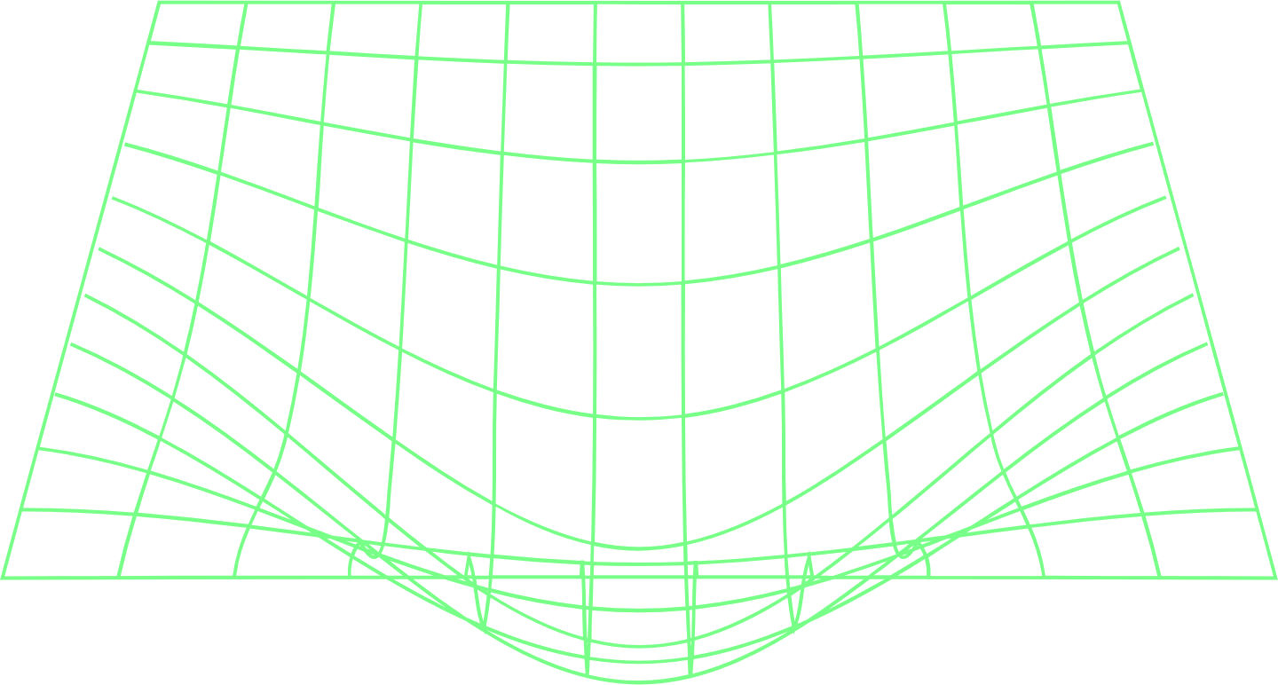
SWOT
Artificial neural networks (ANNs) are computational models that mimic the structure and function of biological neurons. They are widely used in various fields such as computer vision, natural language processing, speech recognition, and more.
STRENGTHS:
ANNs can learn from data and adapt to changing environments, making them flexible and robust.
ANNs can handle complex and nonlinear problems that are difficult to solve with traditional methods.
ANNs can capture hidden patterns and features that are not easily observable by humans or other algorithms.
ANNs can parallelize computation and leverage the power of modern hardware such as GPUs and TPUs.
WEAKNESSES:
ANNs require a lot of data and computational resources to train and run, which can be costly and time-consuming.
ANNs are often seen as black boxes, meaning that their internal workings and decision-making processes are not transparent or interpretable.
ANNs can suffer from overfitting, underfitting, or generalization issues, which can affect their performance and reliability.
ANNs can be vulnerable to adversarial attacks, which are malicious inputs that are designed to fool or manipulate the network.
OPPORTUNITIES:
ANNs have a huge potential to improve various aspects of human life, such as health care, education, entertainment, security, and more.
ANNs can enable new applications and innovations that were not possible before, such as self-driving cars, virtual assistants, facial recognition, and more.
ANNs can benefit from the advances in artificial intelligence research and development, such as deep learning, reinforcement learning, generative models, and more.
ANNs can collaborate with other technologies and disciplines, such as neuroscience, psychology, biology, physics, and more.
THREATS:
ANNs can pose ethical, social, and legal challenges, such as privacy, bias, fairness, accountability, and regulation.
ANNs can create new risks and dangers, such as cyberattacks, accidents, misuse, or abuse.
ANNs can compete with or replace human workers in some domains or tasks, which can cause unemployment or inequality.
ANNs can raise existential questions about the nature and future of humanity and intelligence.

Slide 29
↖ ↗
↘ ↙
MARKET
RESEARCH
2
ELABORATE ON WHAT YOU WANT TO DISCUSS

Slide 30



MARKET RESEARCH
One of the sessions will focus on how to create market research using artificial neural networks. You will learn how to use three data sets to generate insights and recommendations for your business. Here are some examples of what you can expect:
customers who are satisfied with your current product. You can use this data to identify the strengths and weaknesses of your product, and how to improve it.
customers who are likely to switch to a competitor's product in the next six months. You can use this data to understand the reasons behind their dissatisfaction, and how to retain them.
This is the percentage of customers who are interested in a new feature that you are planning to launch. You can use this data to estimate the demand and potential revenue of your new feature, and how to market it.

Slide 31
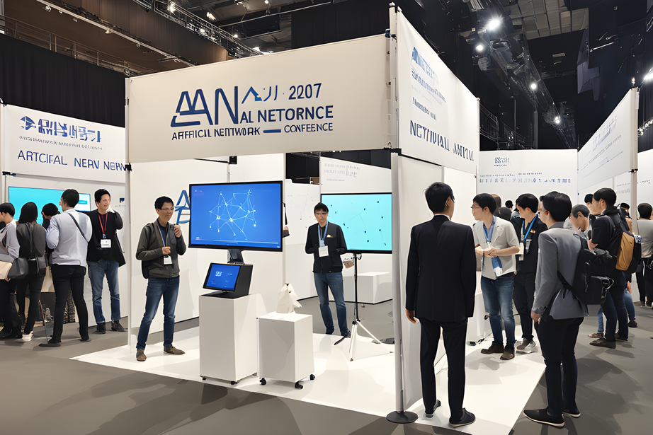
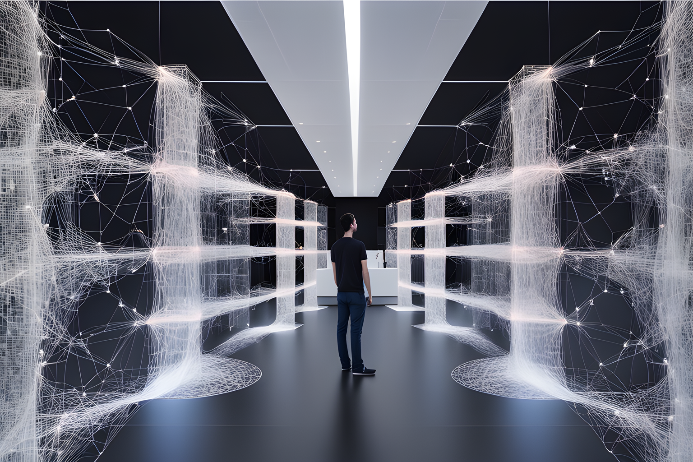
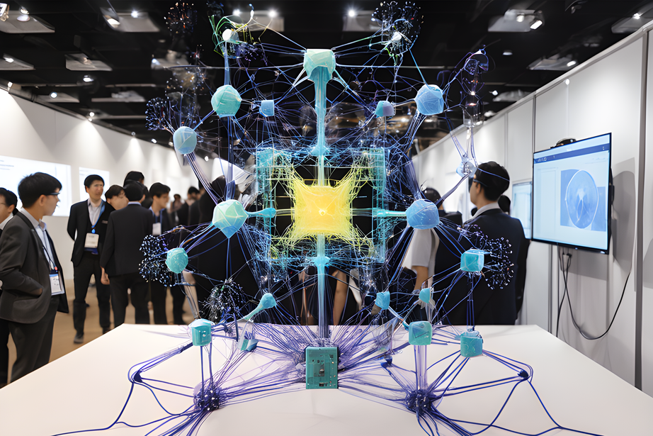
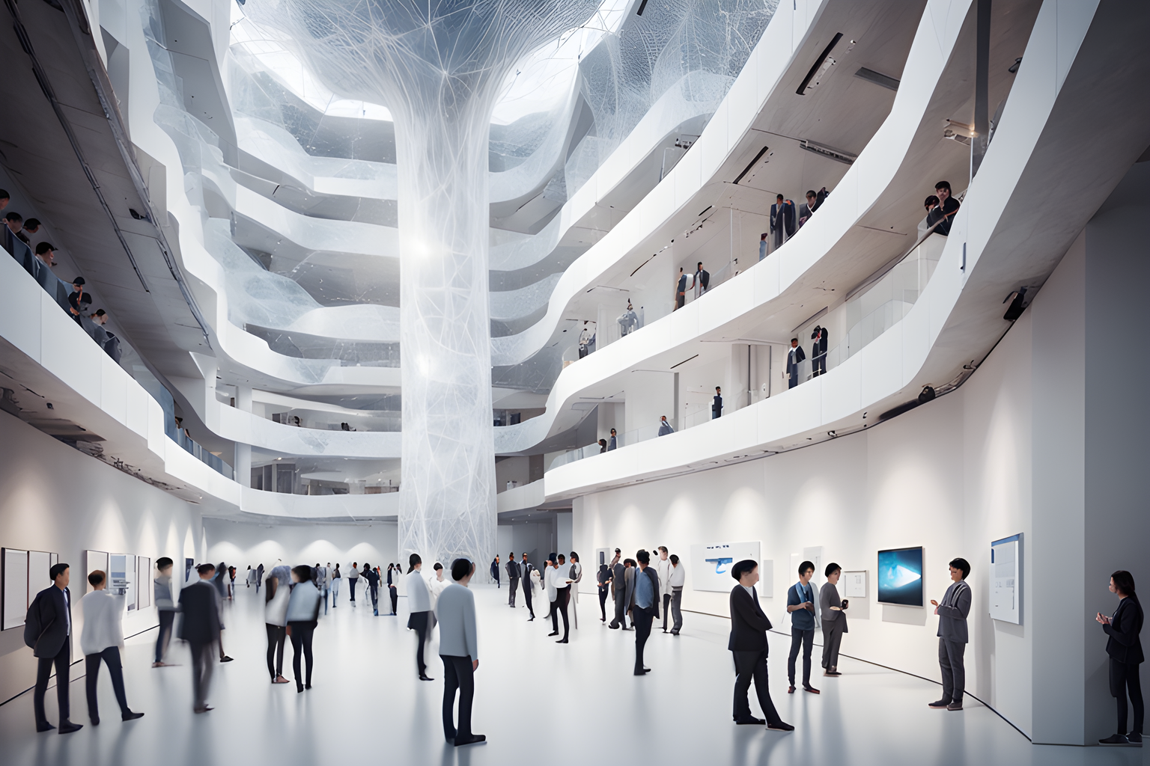
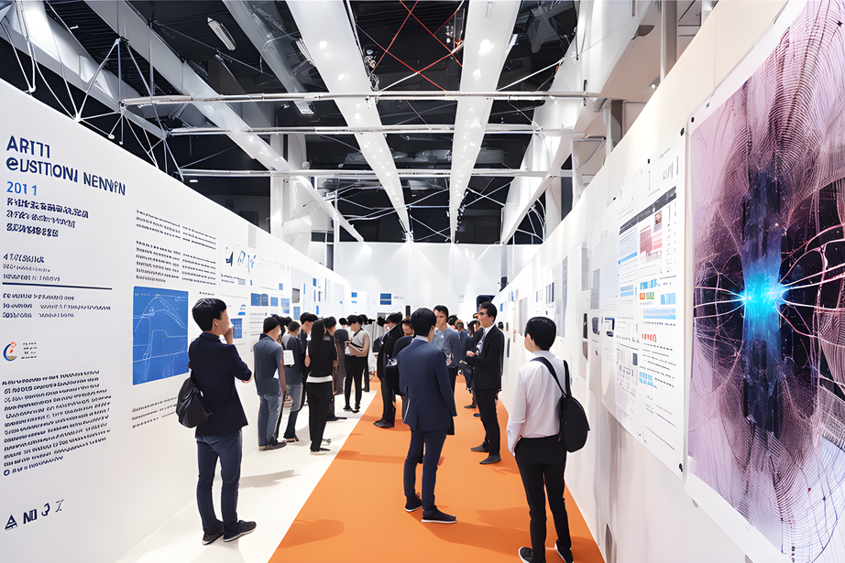
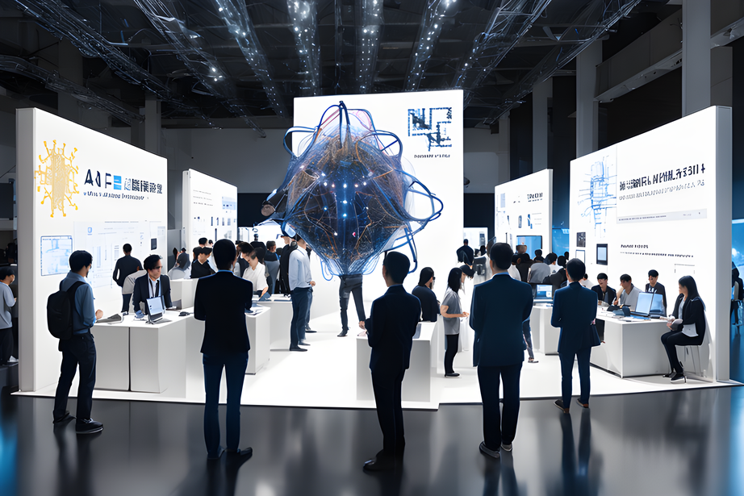
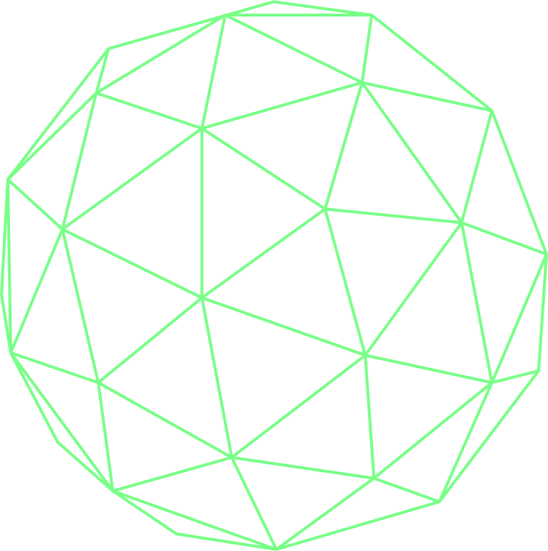
GALLERY

Slide 32
↖ ↗
↘ ↙
ANNUAL
PROJECTS
3
ELABORATE ON WHAT YOU WANT TO DISCUSS

Slide 33
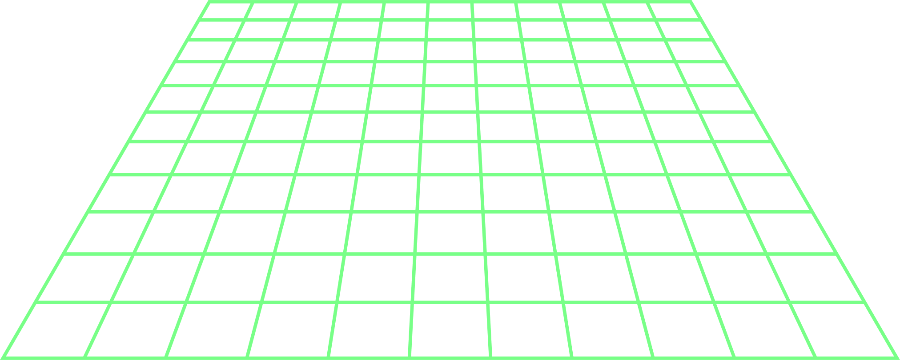
PROJECTS
Artificial neural network conference (ANNC) is a global event that brings together researchers, practitioners, and enthusiasts of artificial neural networks and related fields. ANNC aims to foster collaboration, exchange of ideas, and dissemination of cutting-edge research in this rapidly evolving domain.
This year, ANNC is curating four annual projects that showcase the latest advances and applications of artificial neural networks. These projects are:
↖ ↗
↘ ↙
↖ ↗
↘ ↙
↖ ↗
↘ ↙
ANNC CHALLENGE
ANNC WORKSHOP
ANNC SYMPOSIUM
A competition that challenges participants to solve real-world problems using artificial neural networks. The challenge covers various domains such as computer vision, natural language processing, speech recognition, and more. The winners will receive cash prizes and recognition from the ANNC community.
A series of workshops that provide hands-on tutorials, demonstrations, and discussions on various topics related to artificial neural networks. The workshops are led by experts and practitioners from academia and industry. The workshops are open to all attendees of ANNC and offer a valuable opportunity to learn new skills and techniques.
A symposium that features invited talks, panel discussions, and poster sessions on the latest research and developments in artificial neural networks. The symposium covers a wide range of topics such as deep learning, reinforcement learning, generative models, explainable AI, and more. The symposium is a platform for sharing insights, perspectives, and challenges in the field of artificial neural networks.

Slide 34
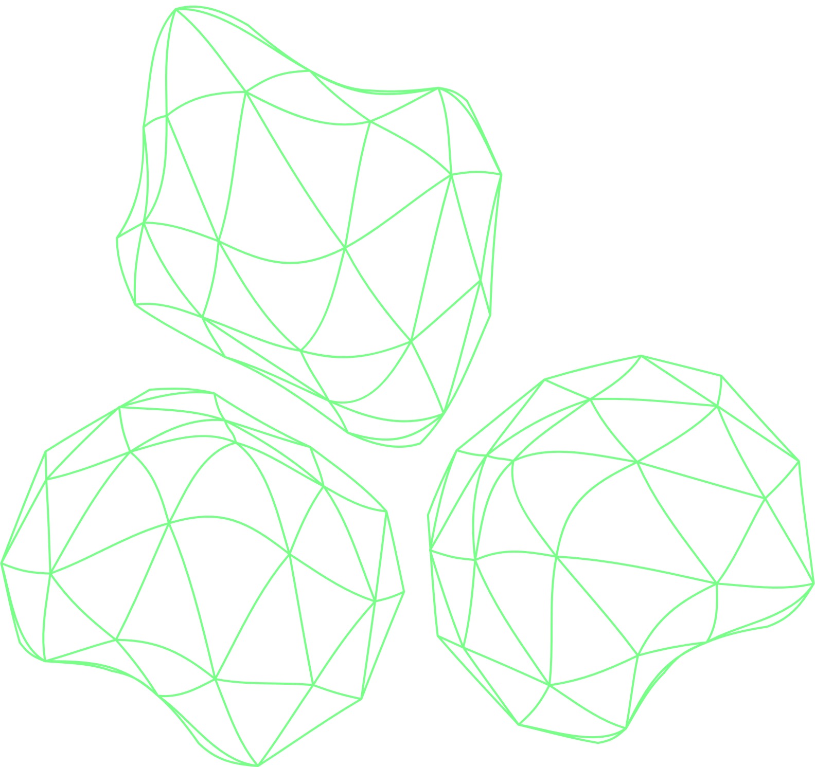
CONTACTS
123 Anywhere St., Any City,ST 12345
123-456-7890
hello@annc2023.com
@annc2023
↙
ANNC2023.DEV

Slide 35
CREDITS
This presentation template is free for everyone to use thanks to the following:
SlidesCarnival for the presentation template
Pexels for the photos
HAPPY DESIGNING!

Slide 36
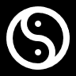
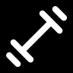
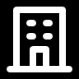
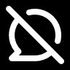
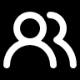
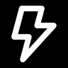
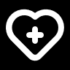
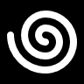
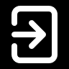
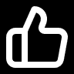
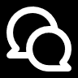
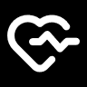
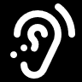
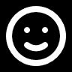
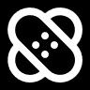
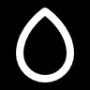
































CREDITS
Use these design resources in your Canva Presentation.
You can find these fonts online too. Happy designing!
Don't forget to delete this page before presenting.
This presentation template uses the following free fonts:
Titles: Anantason UltraExpanted
Headers: Anantason UltraExpanted
Body Copy: Codec﻿ Pro
HAPPY DESIGNING!

Slide 37


FREE TEMPLATES FOR ALL YOUR PRESENTATION NEEDS
For PowerPoint, Google Slides, and Canva
100% free for personal or commercial use
Ready to use, professional, and customizable
Blow your audience away with attractive visuals

